Slide 1
STEP 4 - STORYBOARDING
Every application tells a story…

Slide 2

Step 4 Storyboarding
The story of how we get from A to B
Answers questions about how users will user your app
Does it flow?
Is it easy to get the job done?
Are there any blockers or hurdles?

Slide 3
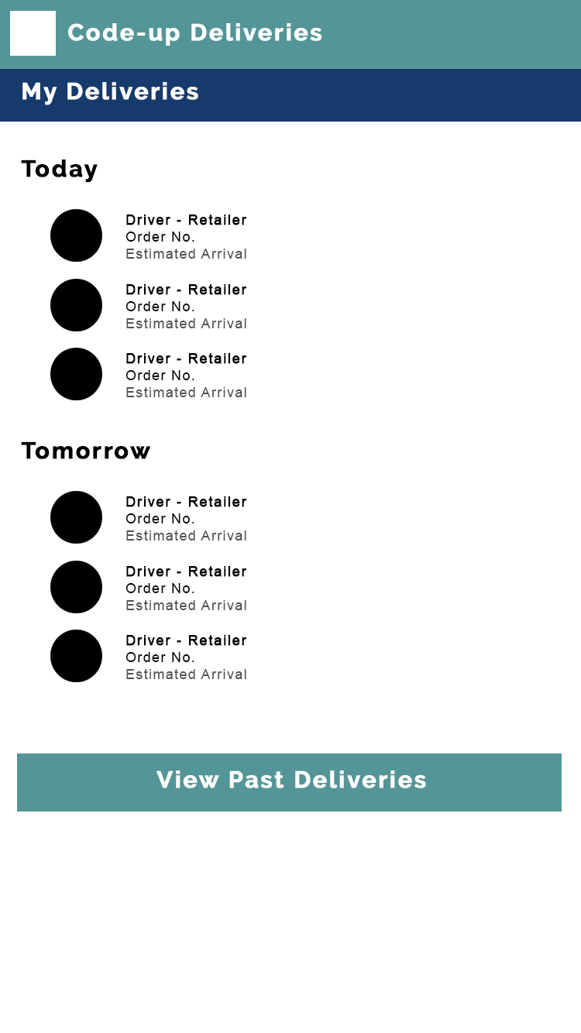
Step 4 Storyboarding
Making a storyboard:
Pen & Paper
Post-it notes or index cards
Online tools such as InVision or Canva
Desktop tools like Photoshop or Gimp

Slide 4
CHALLENGE TIME!
Take a look at my storyboard in the resources and make a basic one for your application
It doesn’t have to be detailed and can even be done using pen and paper if preferred
Share your storyboard with us in the Slack boards!

Slide 5
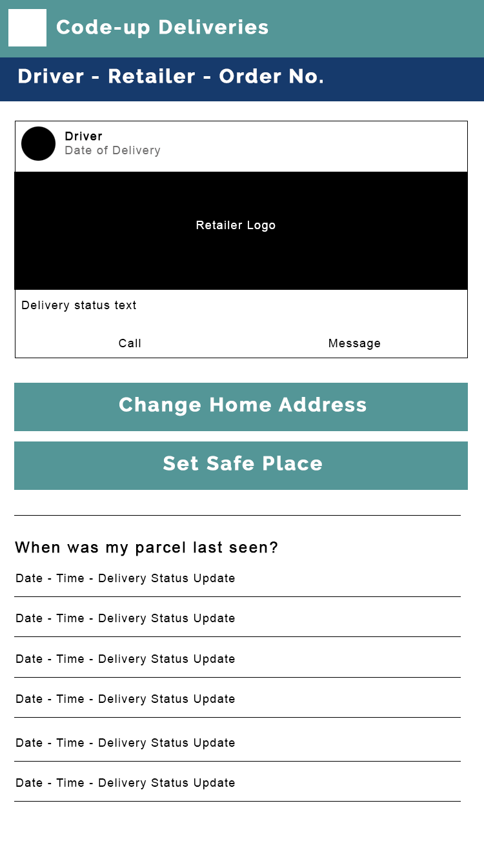
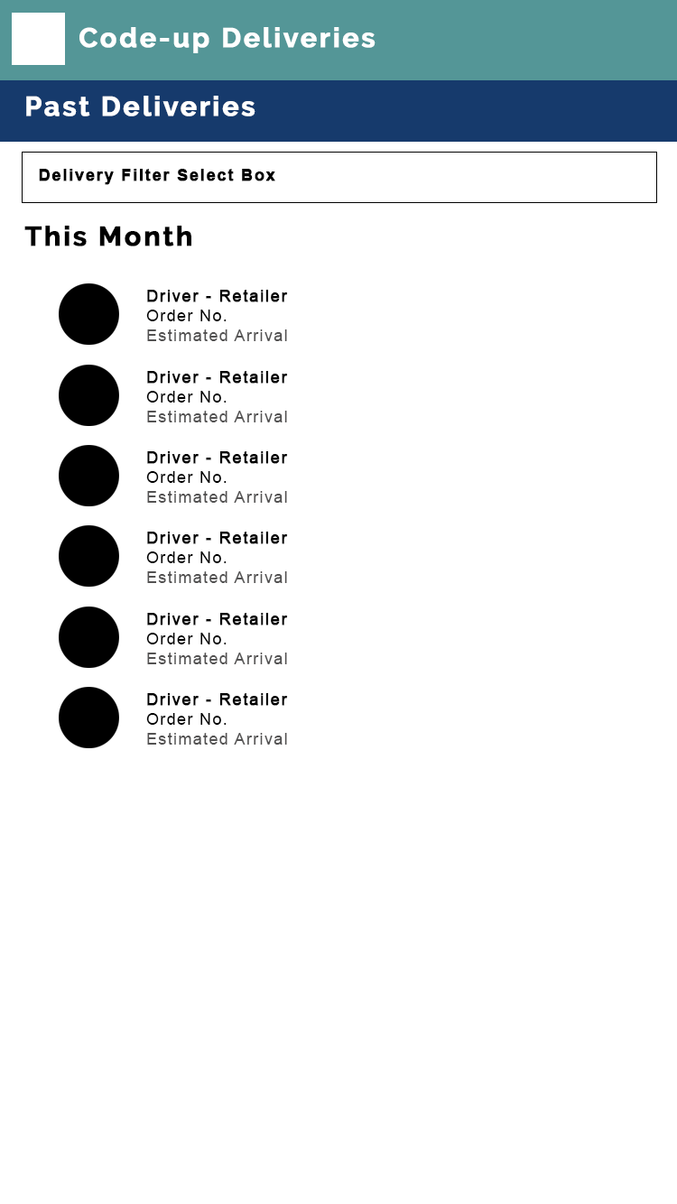
Step 4 Storyboarding
Lets take a look the storyboards for the rest of our mobile app
Simple shapes
No images
No font styling
Minimal colour used
Let’s see these uploaded to the Invision tool…

